Slide 1
CPU Design Verification Environment
Haroon Shafique
10xEngineers

Slide 2
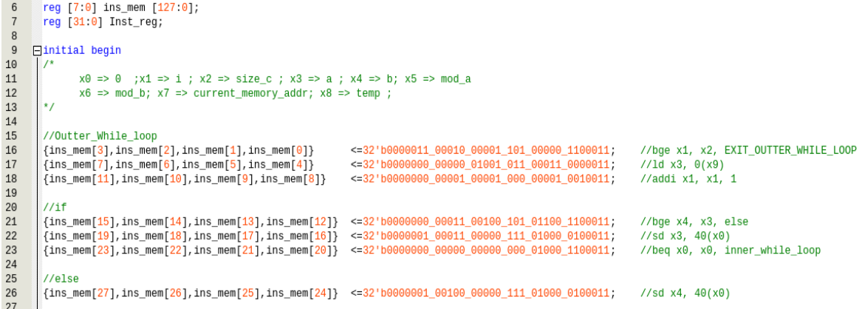
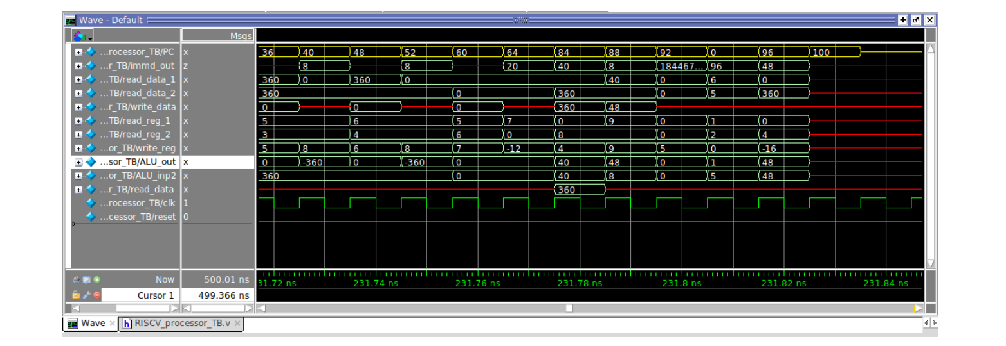
Building Blocks of
CPU Verification
RTL (Obviously!)
Testbench
Instantiates DUT
Drivers, Monitors etc
Stimulus
Checker

Slide 3
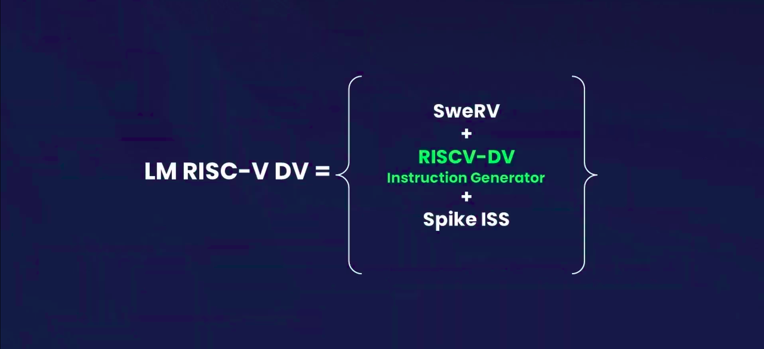

Slide 4
Open Source Ecosystem
RTL = SweRV EH-1
32-bit CPU core
9-stage pipeline, dual-issue
supports RISC-V’s integer (I), compressed instruction (C), multiplication and division (M), and instruction-fetch fence and CSR instructions (Z) extensions,
mostly in-order pipeline with some out-of-order execution

Slide 5
Open Source Ecosystem
Test Generator = RISCV-DV
Supported instruction set: RV32IMAFDC, RV64IMAFDC
Supported privileged mode: machine mode, supervisor mode, user mode
Page table randomization and exception
Privileged CSR test suite
Trap/interrupt handling
Random forward/backward branch instructions
Instruction generation coverage model
Handshake communication with testbench
Co-simulation with multiple ISS : spike, riscv-ovpsim, whisper, sail-riscv

Slide 6
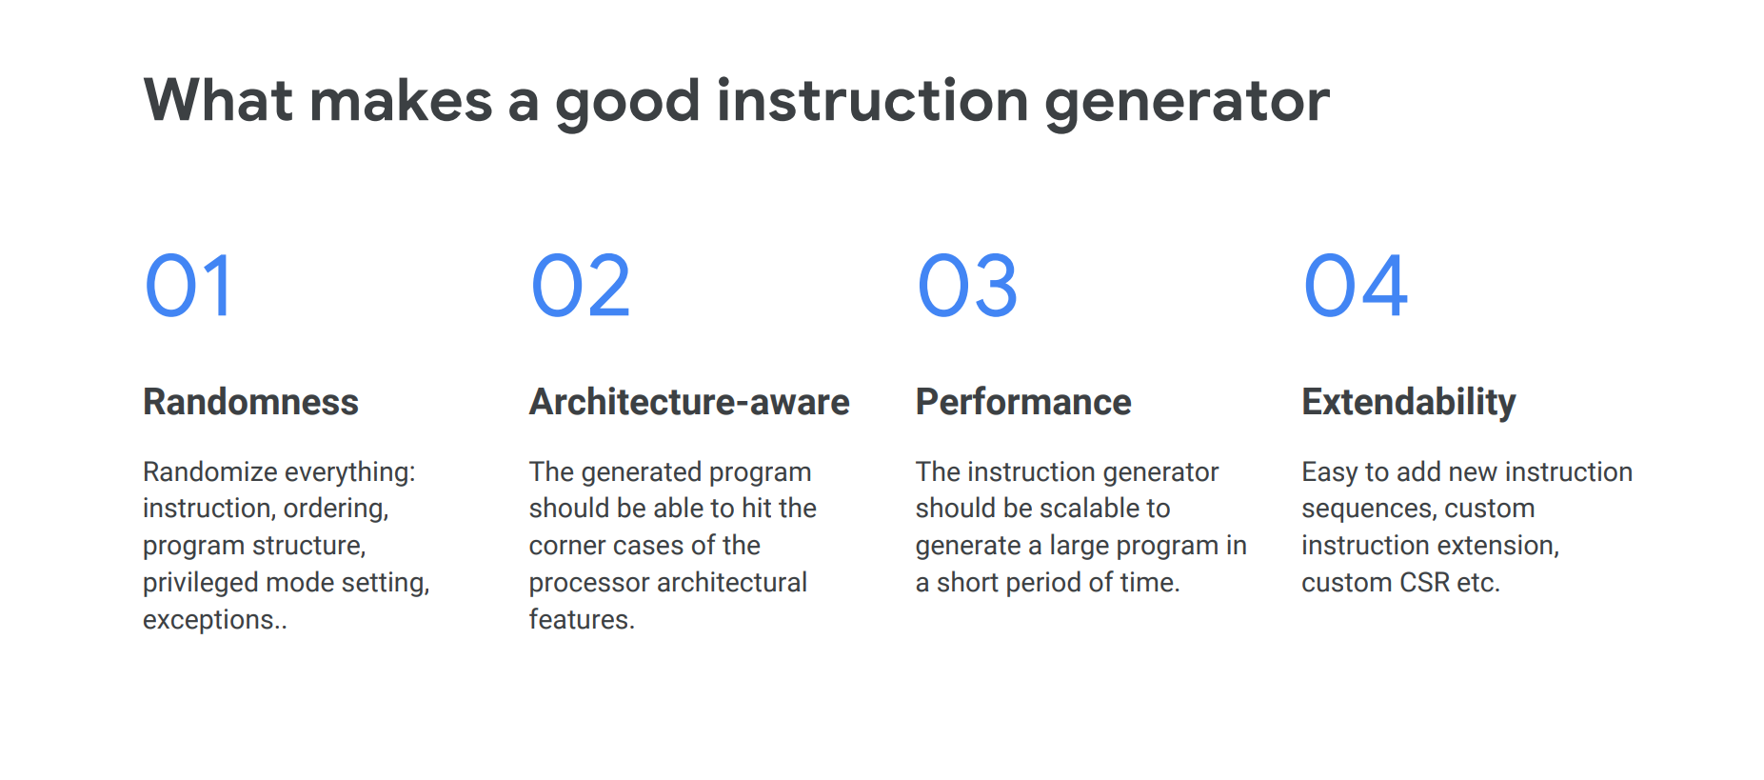
Sample test

Slide 7
Open Source Ecosystem
Instruction Set Simulator (ISS) = Spike
RISC-V ISA Simulator which implements a functional model of RISC-V cores.
It Supports:
RV32I and RV64I base ISAs, v2.1
M extension, v2.0
F extension, v2.2
D extension, v2.2
C extension, v2.0
V extension, v1.0 (requires a 64-bit host)
Zba extension, v1.0
Zbb extension, v1.0
Zbc extension, v1.0
Zbs extension, v1.0
Machine, Supervisor, and User modes, v1.11
Hypervisor extension, v0.6.1
+ many more extensions

Slide 8
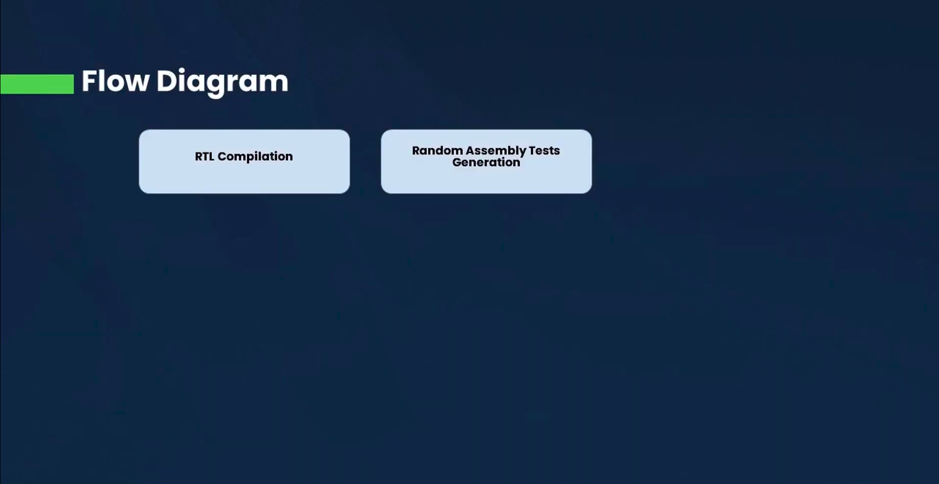

Slide 9
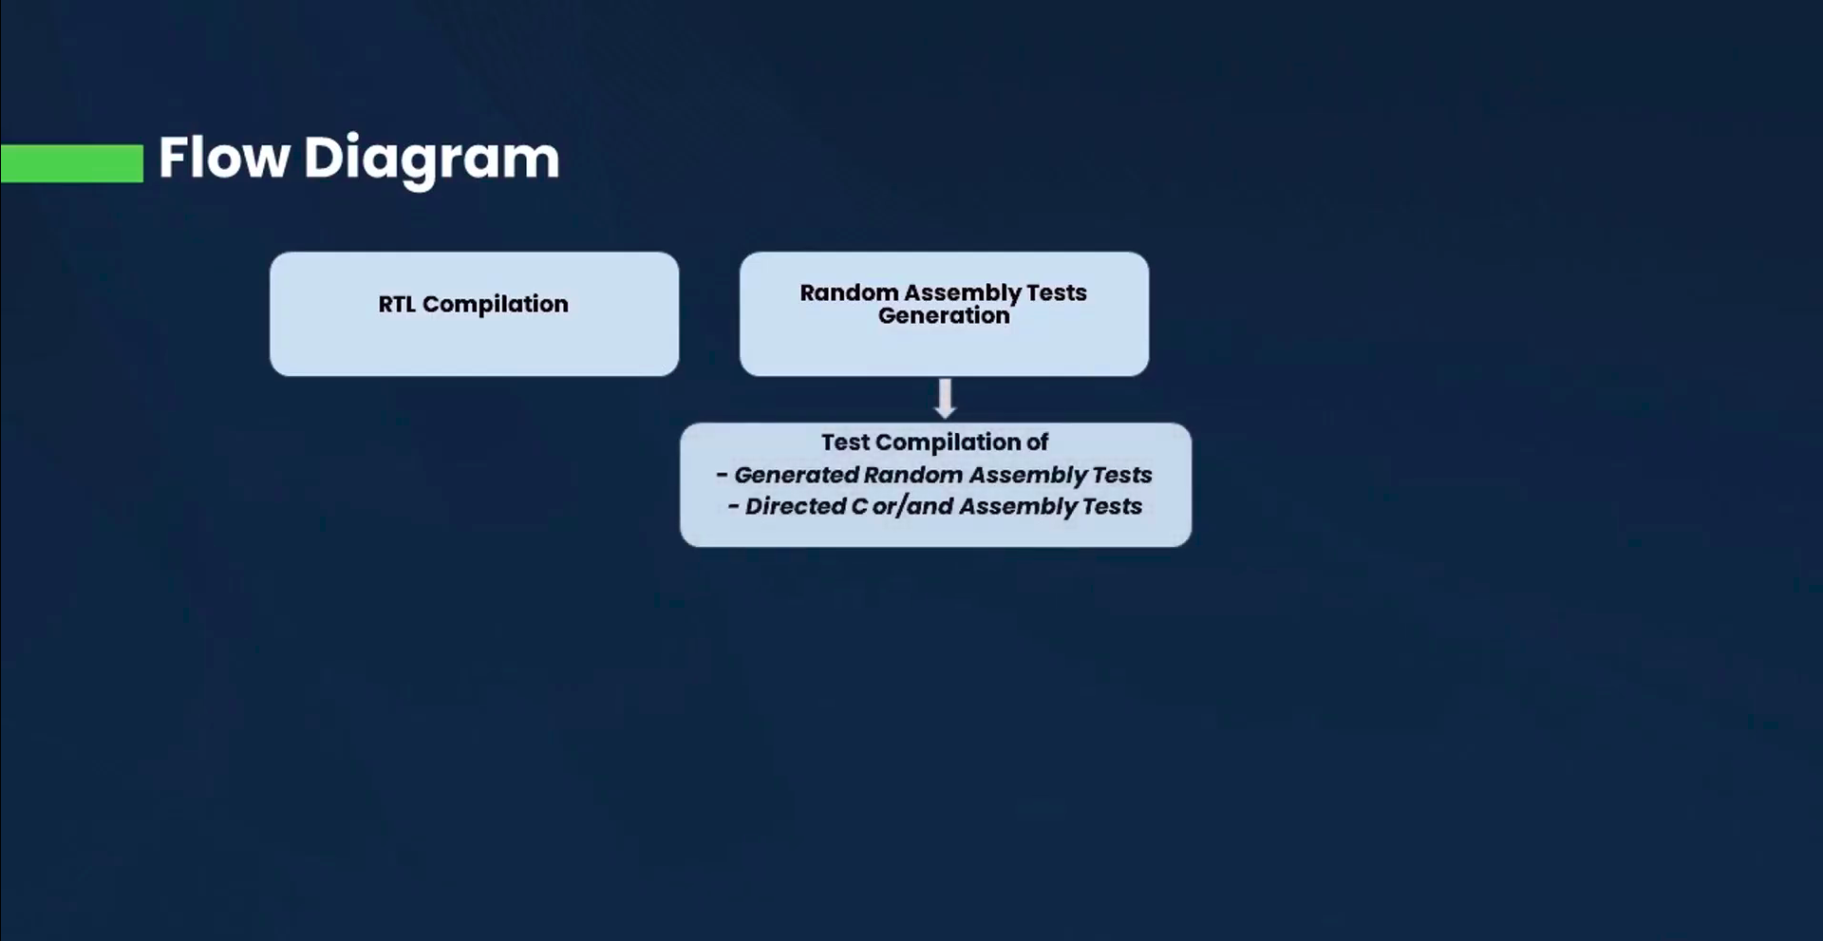

Slide 10
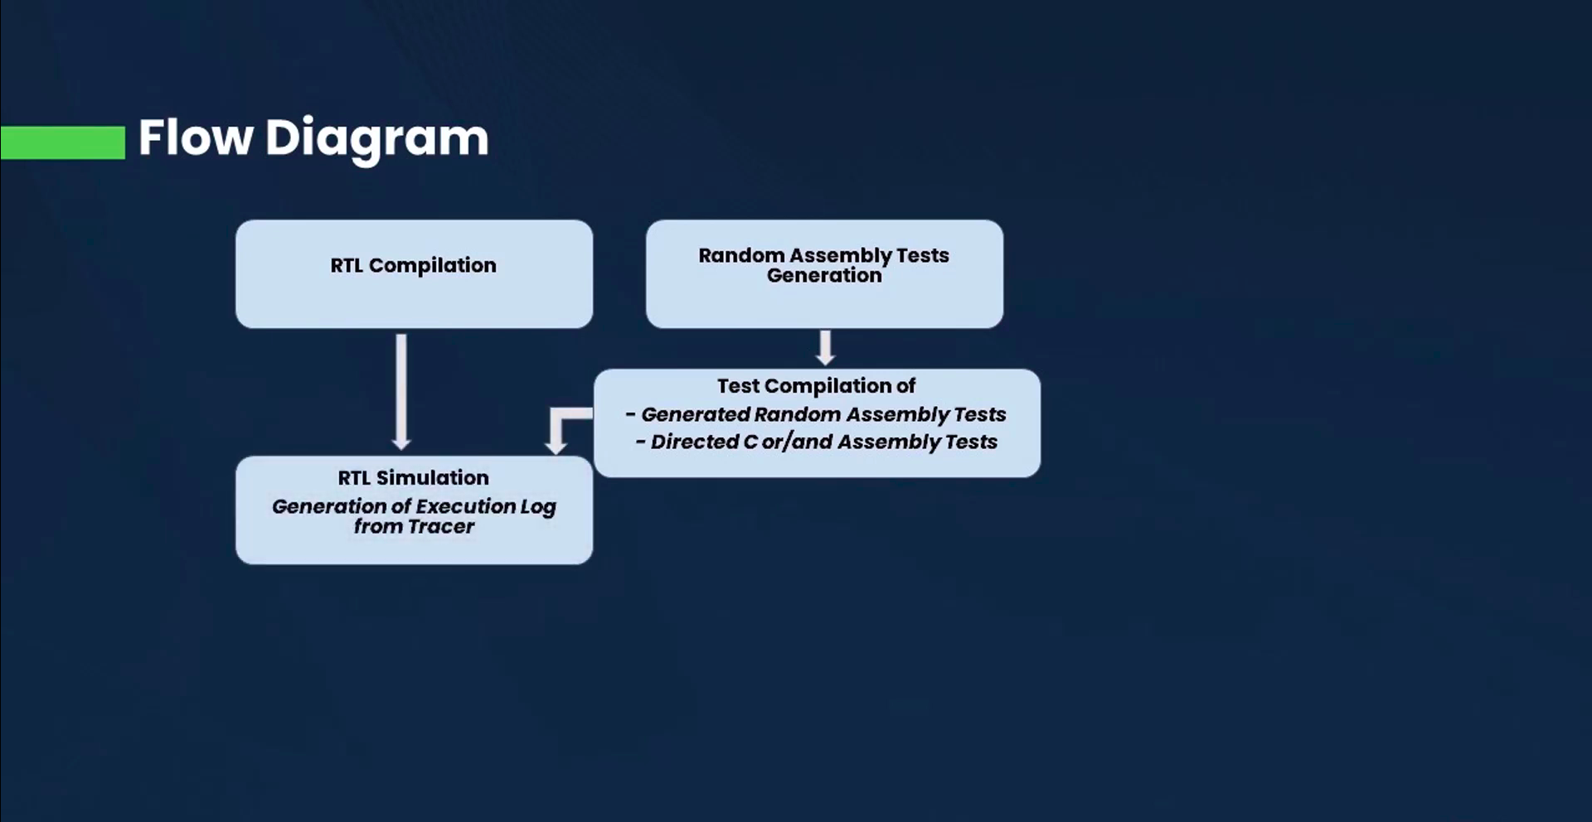

Slide 11
Sample RTL Log

Slide 12
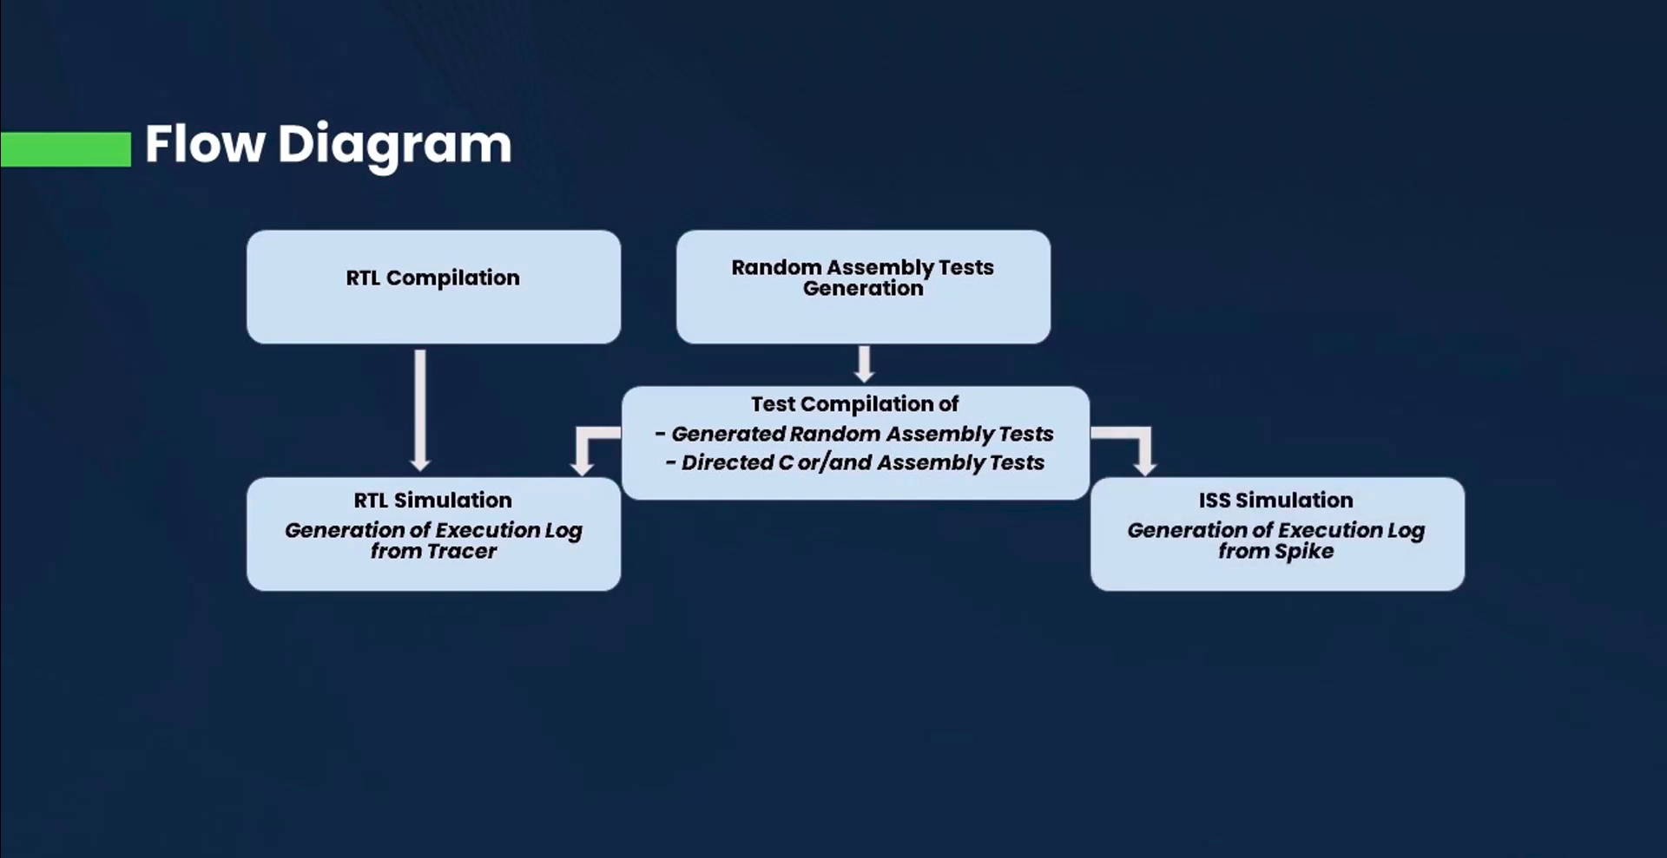

Slide 13
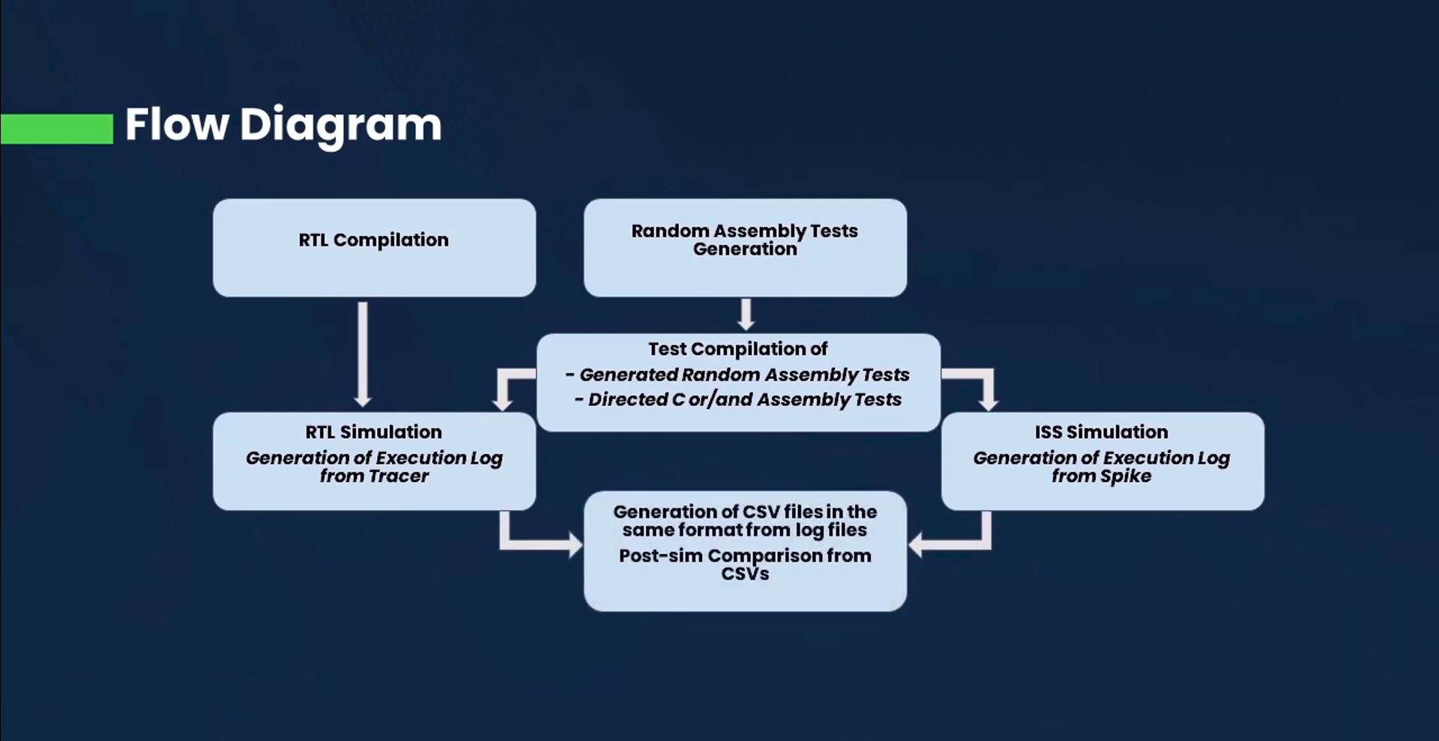

Slide 14
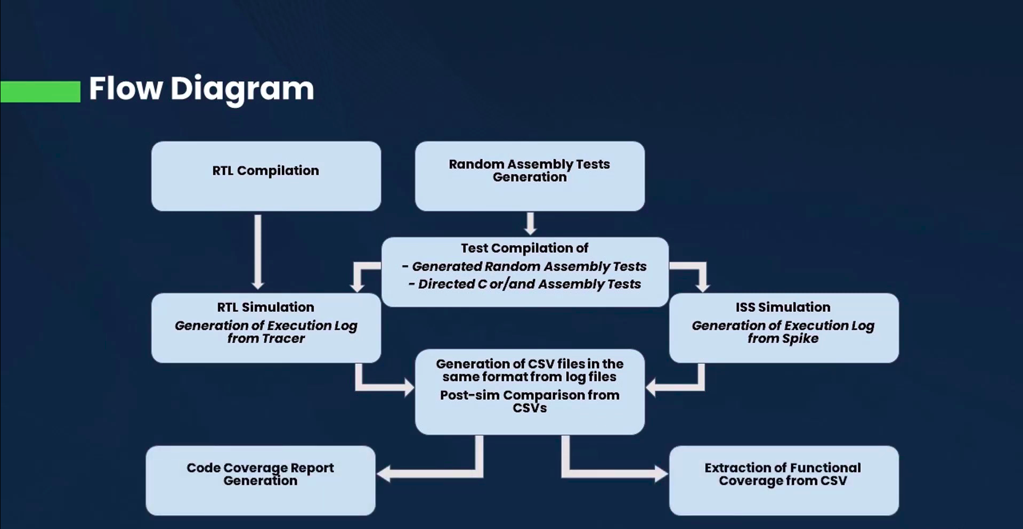

Slide 15
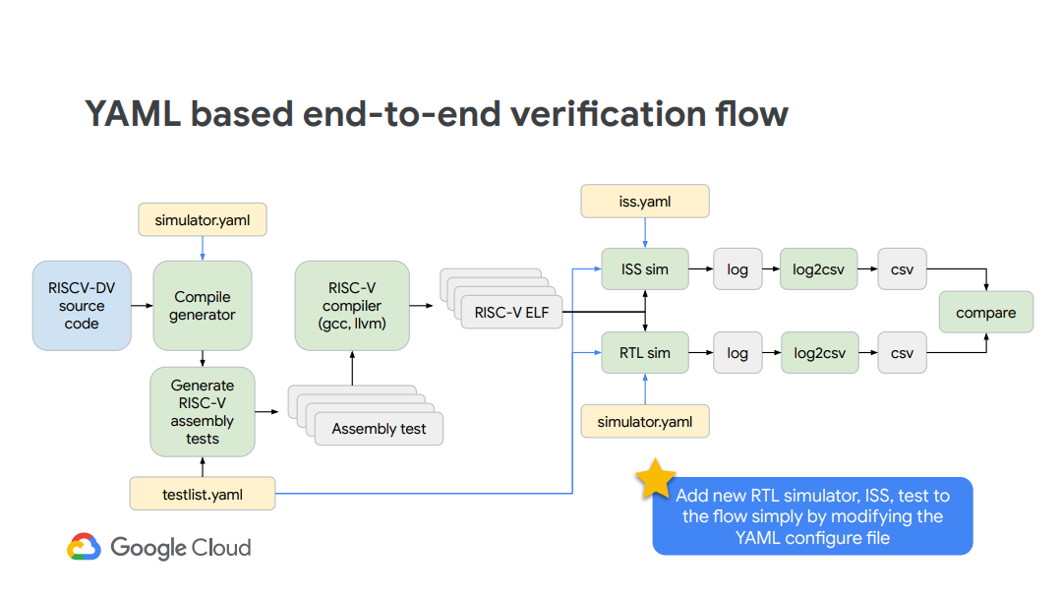

Slide 16
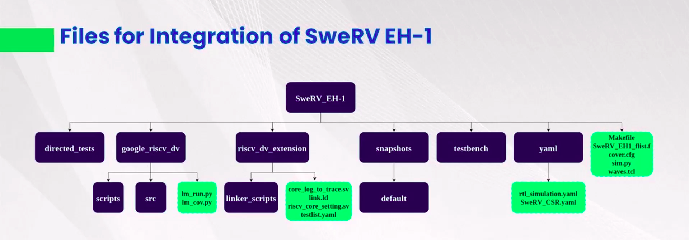

Slide 17
Key Learnings
Version Control System for collaborating and maintaining Source Codes: Git
Cloud/Web based Services for remote and distributed revision control and Source Code Management: Github
Documentation: Markdown
Programming/Scripting Languages and HDLs/HVLs: Python, SystemVerilog, Bash
Tools: VCS, Verilator
Operating Systems: Linux
Editors: Vim, VS Code
Others: Makefiles, YAML files

Slide 18
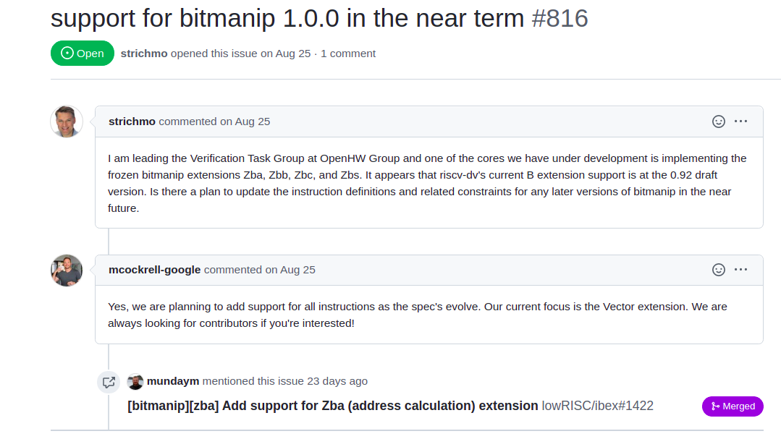
Some Open Issues

Slide 19
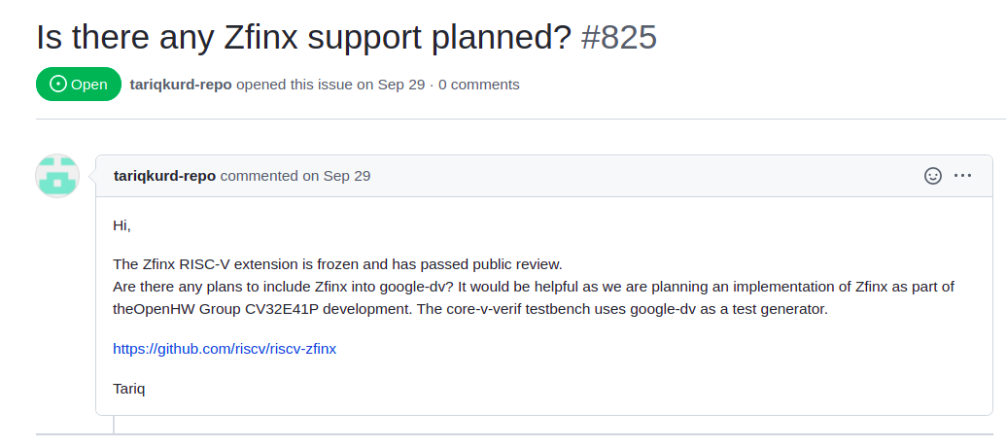
Some Open Issues

Slide 20
Thank You!

